Slide 1
Behind-The -Meter (BTM) Energy Storage Systems(ESS) Optimization Techniques
BY GROUP 13
Ravulapalli Juhi
Bhuvana Singamaneni
Harsh Bokadia
Priyam K Paul
Shikhar Gupta

Slide 2
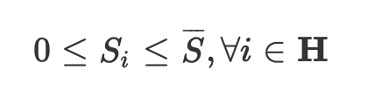
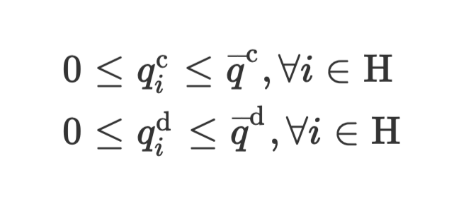
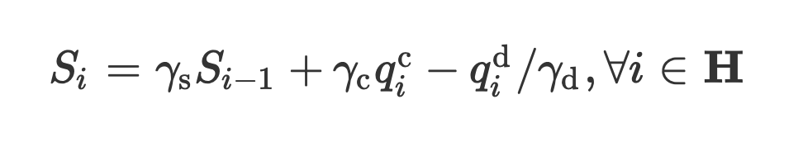
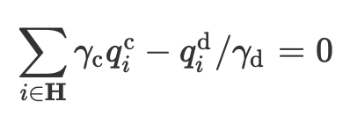
Constant Efficiency Energy Storage Model
For behind-the-meter applications, there are two decision variables in the optimization: the energy discharged
qdi and the energy recharged qci at time i, which are non-negative by convention. They are subjected to the following constraints:
The SOC must be within its physical limits as described in the following constraint:
It should be noted that the “available” capacity at time i is γdSi because of the discharge efficiency. Therefore,
Therefore, the state of charge (SOC) Si at any time i
is given by:
If zero net charging (i.e., the SOC at the last period is equal to the initial SOC) is required, the following constraint must be met:

Slide 3
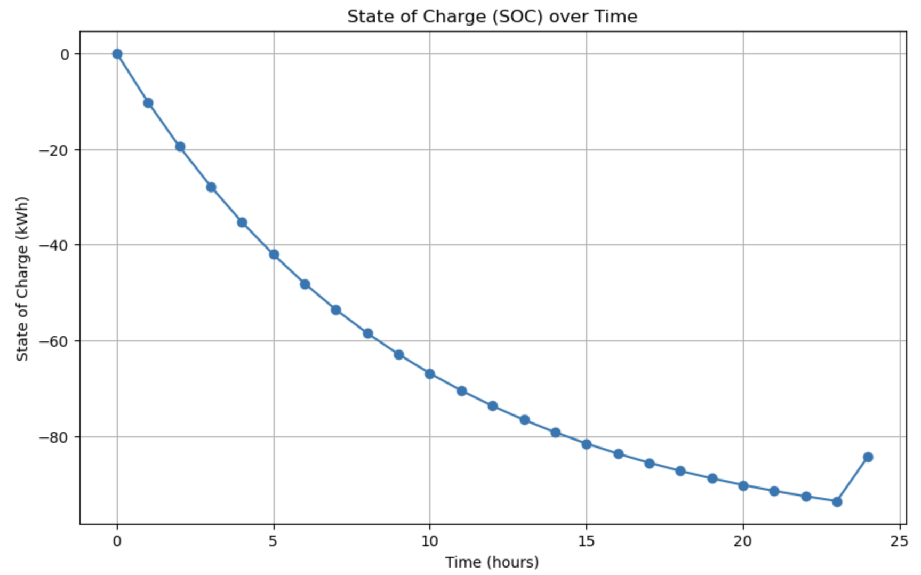
In short, this study examines how behind-the-meter Energy Storage Systems (ESSs) benefits TOU and NEM customers. We can see that ESSs can minimize monthly electricity costs by peak shaving, load shifting, and storing excess renewable energy. Case studies on PG&E's customers show significant cost savings, especially for commercial users. This also explores the impact of ESS size on cost savings and identifies areas for future research. Overall, our findings demonstrate the potential of ESSs to provide sustainable and cost-effective energy solutions for consumers.

Slide 4
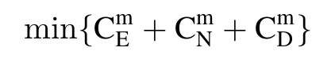
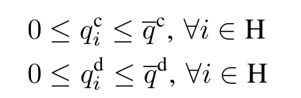

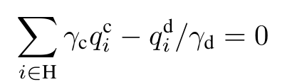
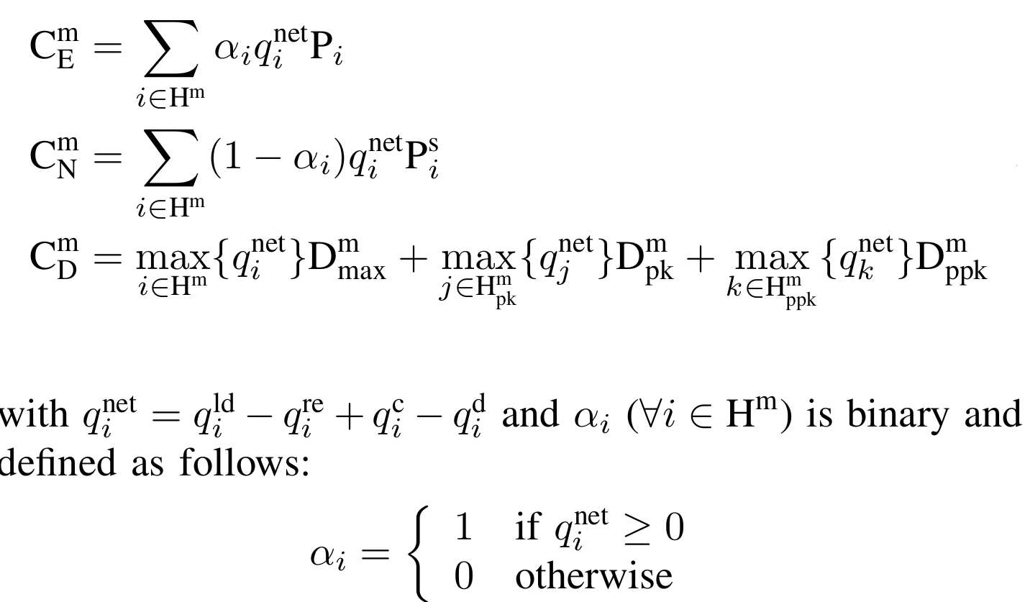
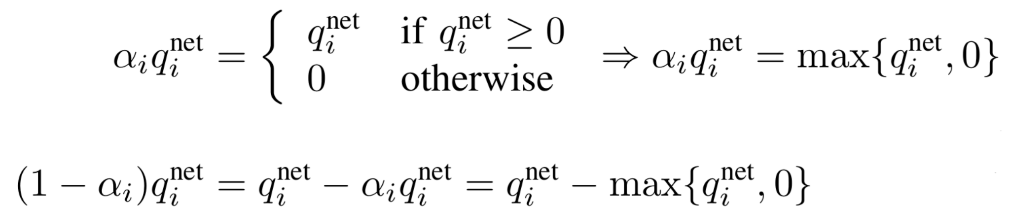
Mixed Integer Nonlinear Programming (MINLP)
This optimization technique known as Mixed Integer Nonlinear Programming (MINLP), coupled with the Minimax technique addresses the complex problem of minimizing monthly electricity costs for customers participating in Time-of-Use (TOU) and Net Metering (NEM) programs using BTM energy storage.
The Cost Minimization Problem Can Be formulated as
Formulation:
The optimization problem is initially formulated as an MINLP, considering various factors such as forecast data of loads, renewable generations, and utility pricing.
The objective is to minimize the monthly electricity cost for customers by optimizing energy charge, demand charge, and net-metering credit.
s.t.
where
To remove the binary variables in the equations,we use:

Slide 5
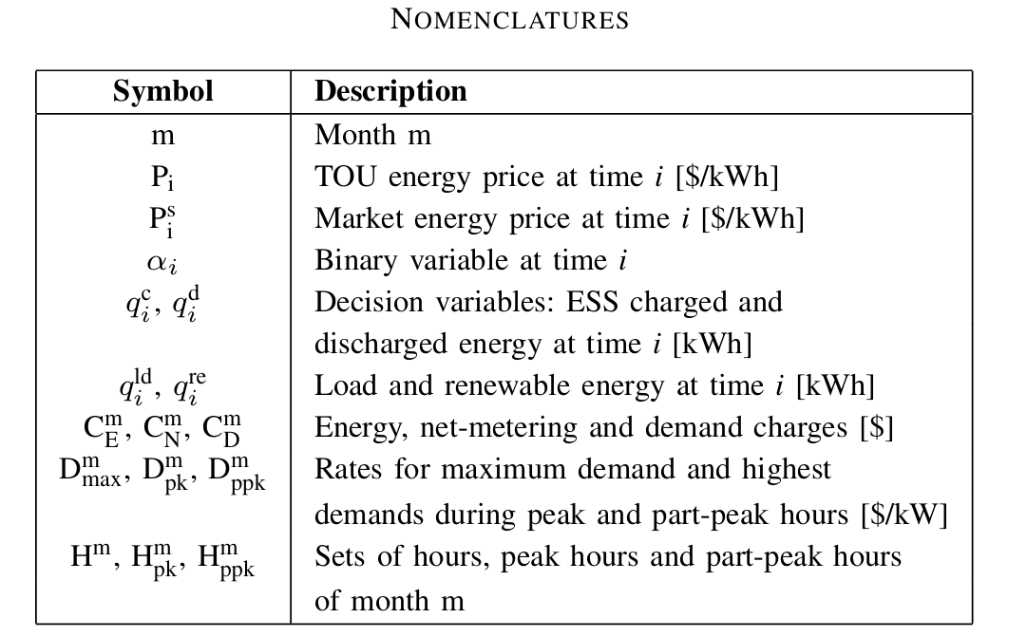
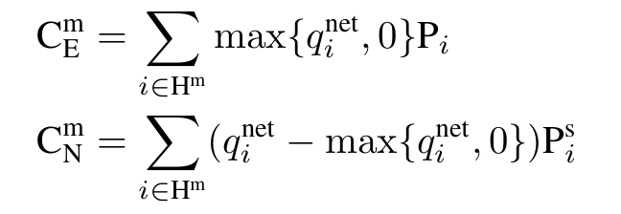
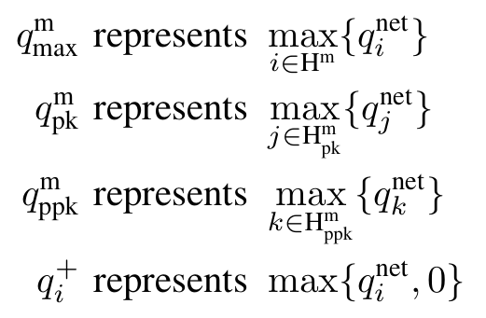
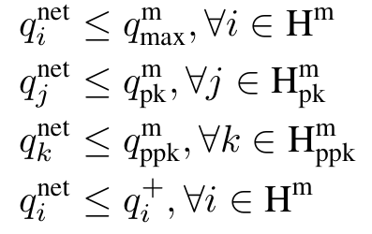
Mixed Integer Nonlinear Programming (MINLP)
The equations can be rewritten as:
The problem now became a Linear Minimax problem, which can be turned into a Linear Programming problem by substituting max terms in the objective function with representative variables together with corresponding constraints.
Representative variables:
Corresponding constraints:
Transformation to LP:
The MINLP problem is then transformed into a more manageable Linear Programming (LP) problem using the Minimax technique.
This transformation simplifies the problem, making it computationally more efficient to solve.

Slide 6
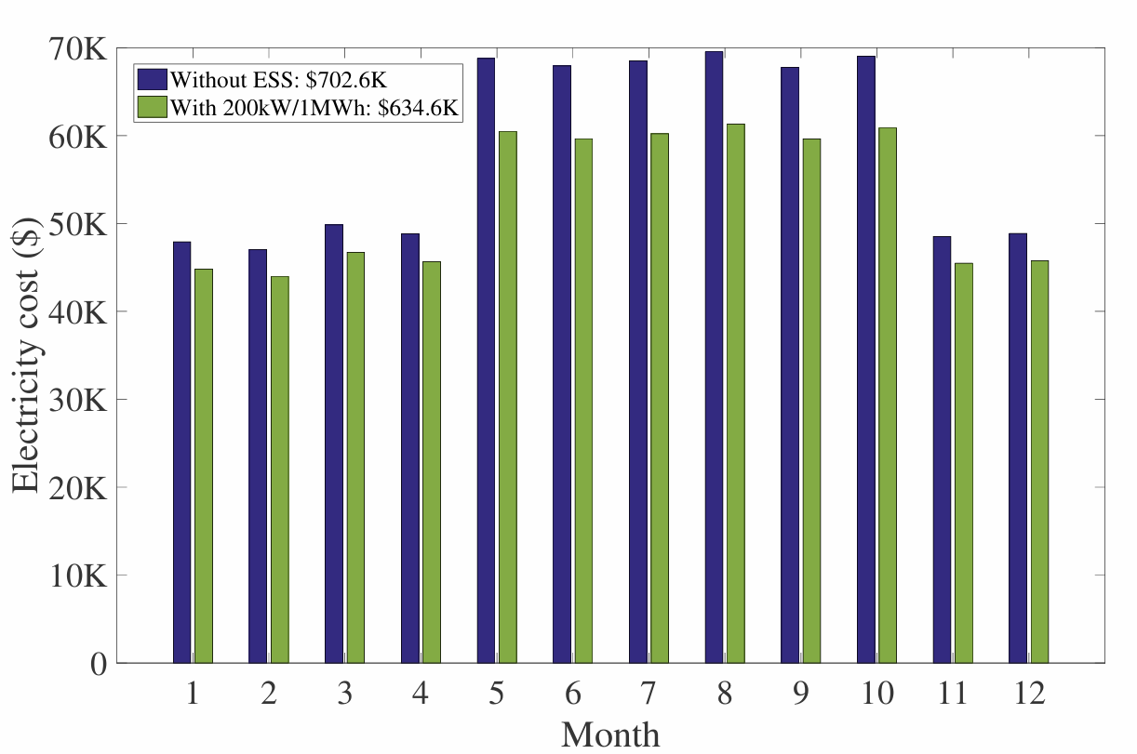
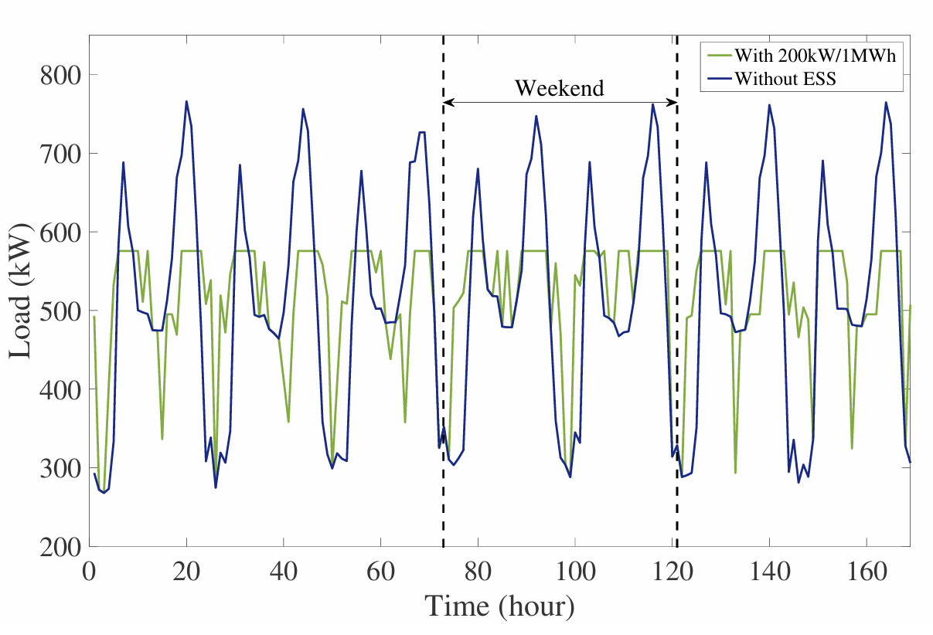
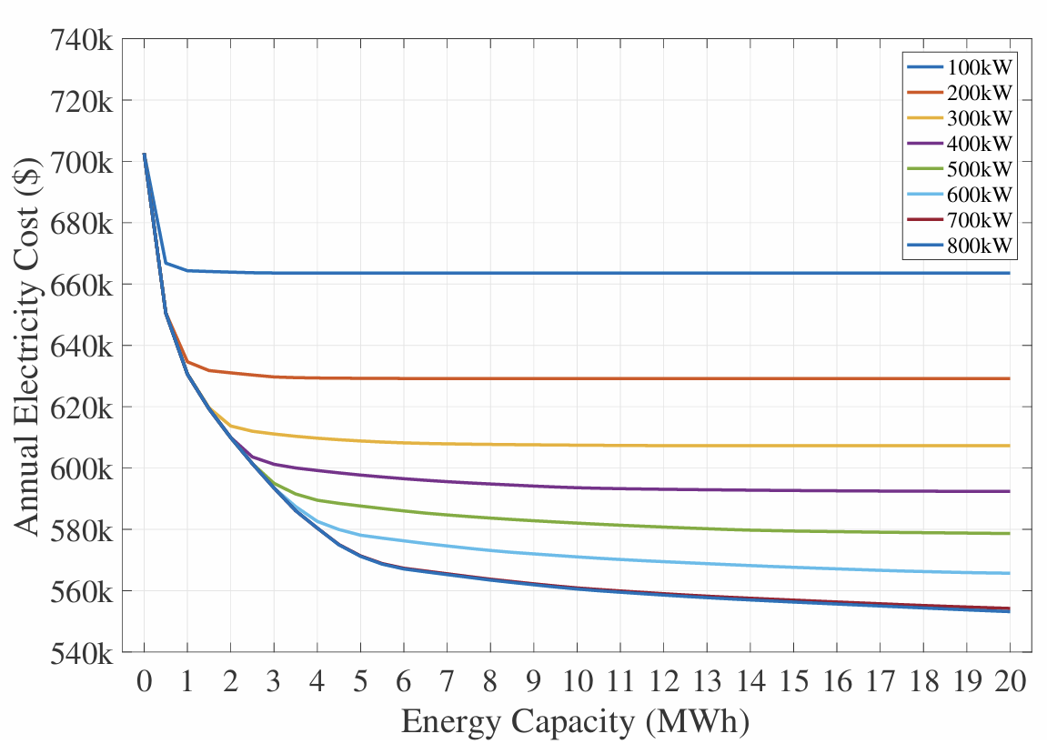
Case Study
The study considers a large hotel as a medium-size commercial customer.
Hourly load profiles based on TMY3 weather data are utilized.
We assume no renewable systems are installed at the customer's site to better evaluate the impact of ESS deployment for the purpose of practicality.
Results show that integrating an Energy Storage System (ESS) significantly reduces monthly electricity costs, especially during summer months.
The ESS effectively shaves peak loads by charging during off-peak hours and discharging during peak hours.
Sensitivity analysis reveals that the annual electricity cost decreases with increasing ESS energy capacity,leveling off beyond a certain point.
The annual electricity bill is reduced from $702,600 (without energy storage) to $634,600 (with a 200 kW/1 MWh ESS), resulting in a savings of $68,000.
Monthly electricity bills with 200kW/1MWh ESS
Net loads during the first week of June
Sensitivity of annual electricity bill to ESS size

Slide 7
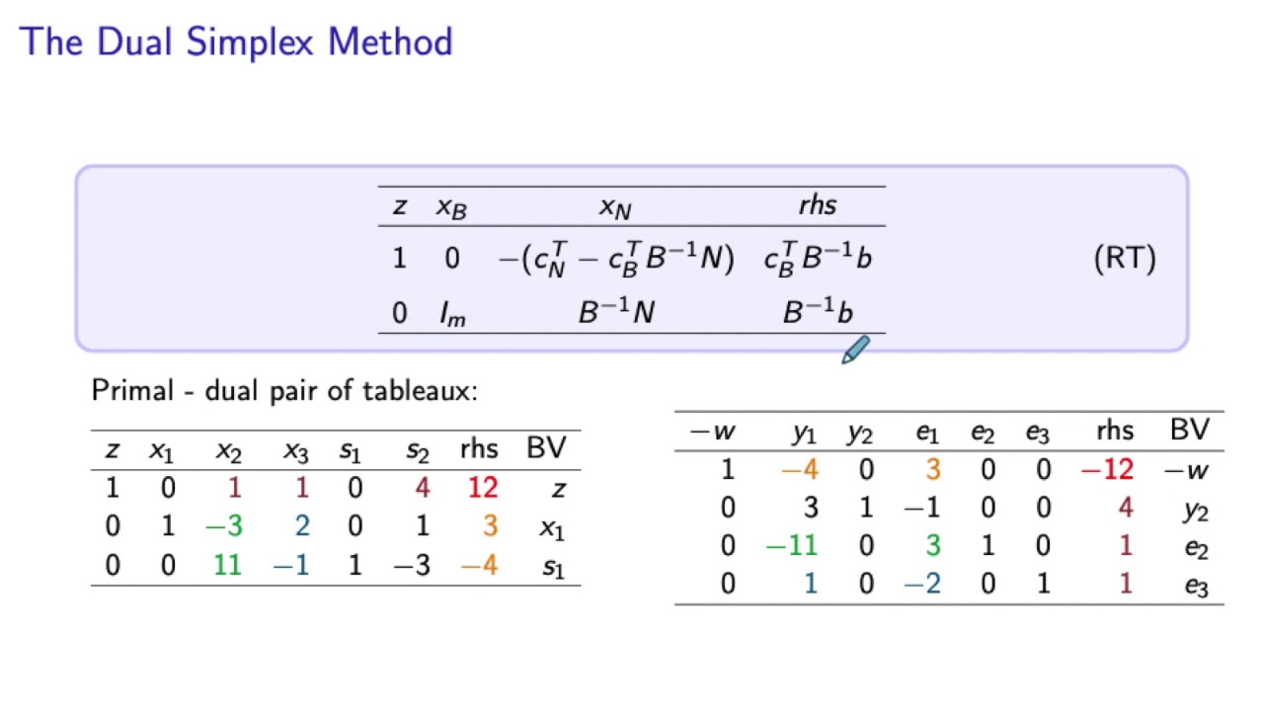
Dual-Simplex LP
Dual simplex is exactly analogous to primal simplex where we start with a dual feasible solution corresponding to a basis B and move towards making the corresponding primal solution feasible while maintaining complementary slackness.

Slide 8
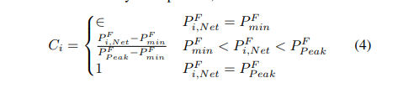
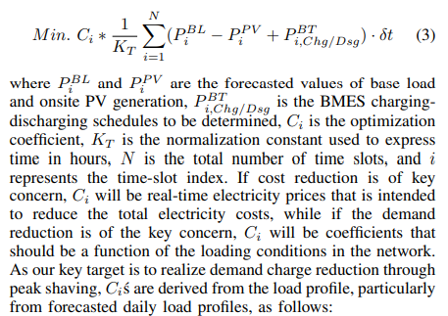
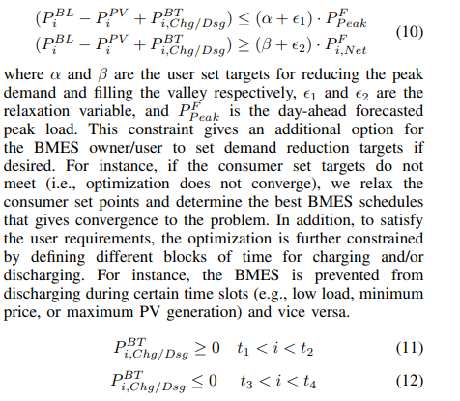
Cost function

Slide 9
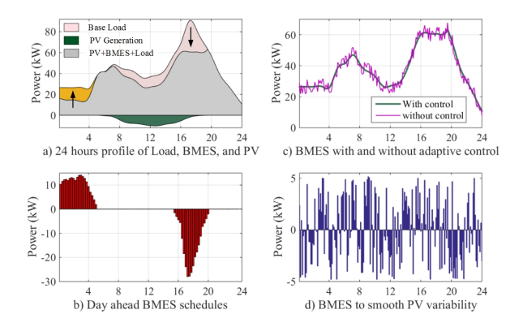
Results

Slide 10
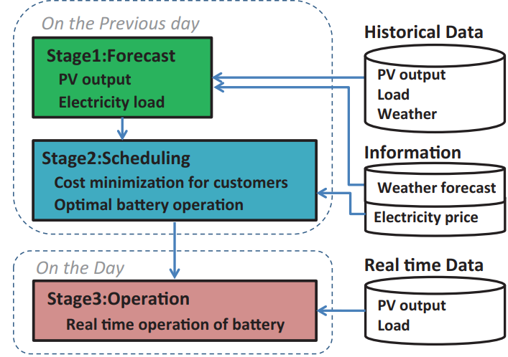
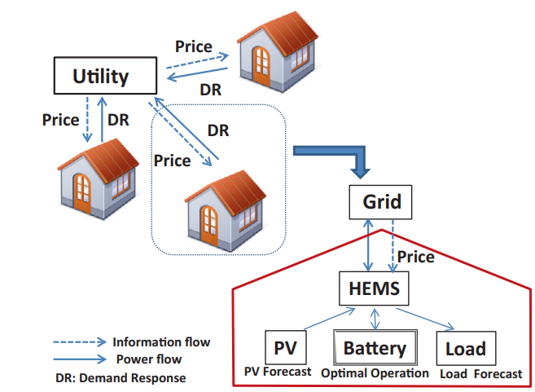

Co-operative HEMS Theory
In this method, we optimize the Home Energy Management System (HEMS) with cooperative use of forecast models for Load and PV generation.
For load forecasting, we used multiple linear regression model (MLR), which could forecast the hourly electricity load for next day before 11 pm. For PV generation forecasts, we used support vector regression.After getting both forecast models, we formed a basic MILP problem for daily battery cost optimization, where we tackled with the buy price and the sell price along with forecasted load and PV generation.
The diagram given above aptly summarizes the idea of how to optimize energy management and minimise the cost function of the individual HEMS.

Slide 11
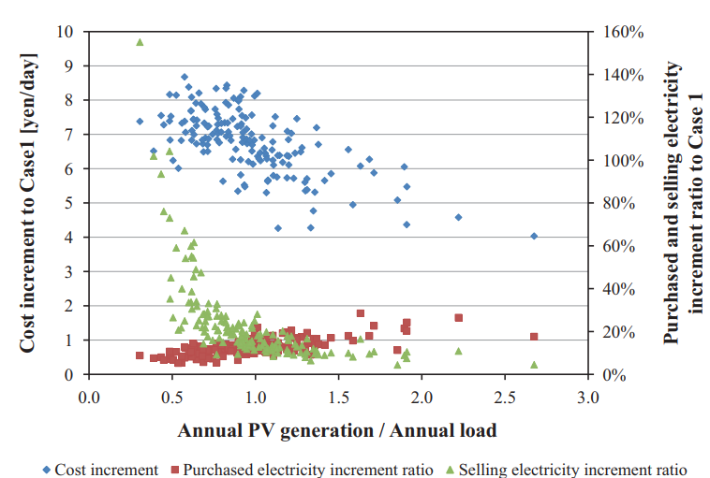

After stumbling upon a research paper that had performed simulations for the same, we got a paper that had simulated the model on 160 households for a year. There were some amounts of errors in the forecasts, which were represented as follows:-
The average cost decrease compared with the normal case is 6.7 yen/day when using load and PV generation forecasts, which corresponds to 2500 yen/year ($25/year), or approximately 6% of the average electricity fee in the 160 households. The largest cost decrease is 8.6 yen/day, which corresponds to 3100 yen/year ($31/year) and 3.1% of the total fee for the households in question.
The formula above represented the root mean square error in forecasting, where Xa_{i} was the actual daily value and Xf_{i} was the forecasted value. There was some amount of impact on the increment of selling prices, but overall, it resulted in optimization of energy management as follows;-

